Slide 1
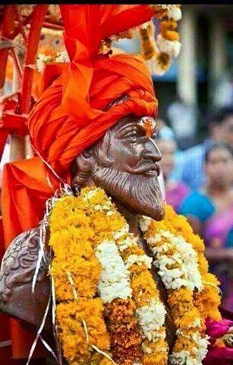
MI MARATHA

Slide 2
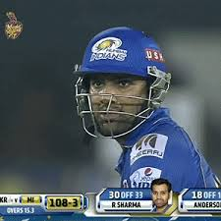
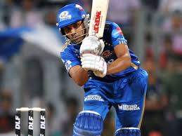
ROHIT SHARMAS STAND

Slide 3
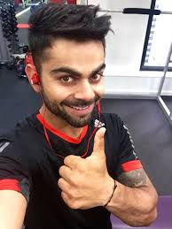
DON’T WORRY ,ALL OK

Slide 4
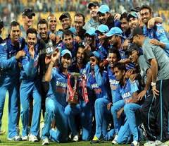
CHAMPIONS

Slide 5
PRATHMESH DESAI

